Slide 1
Social Influence & Matching
OLA 2023 Project
Emanuele Roppo

Slide 2
Objective
Employ online learning algorithms to minimise cumulative regret for the following tasks:
Maximising influence within a social network while operating under a constrained budget.
Optimally matching customers with products.

Slide 3
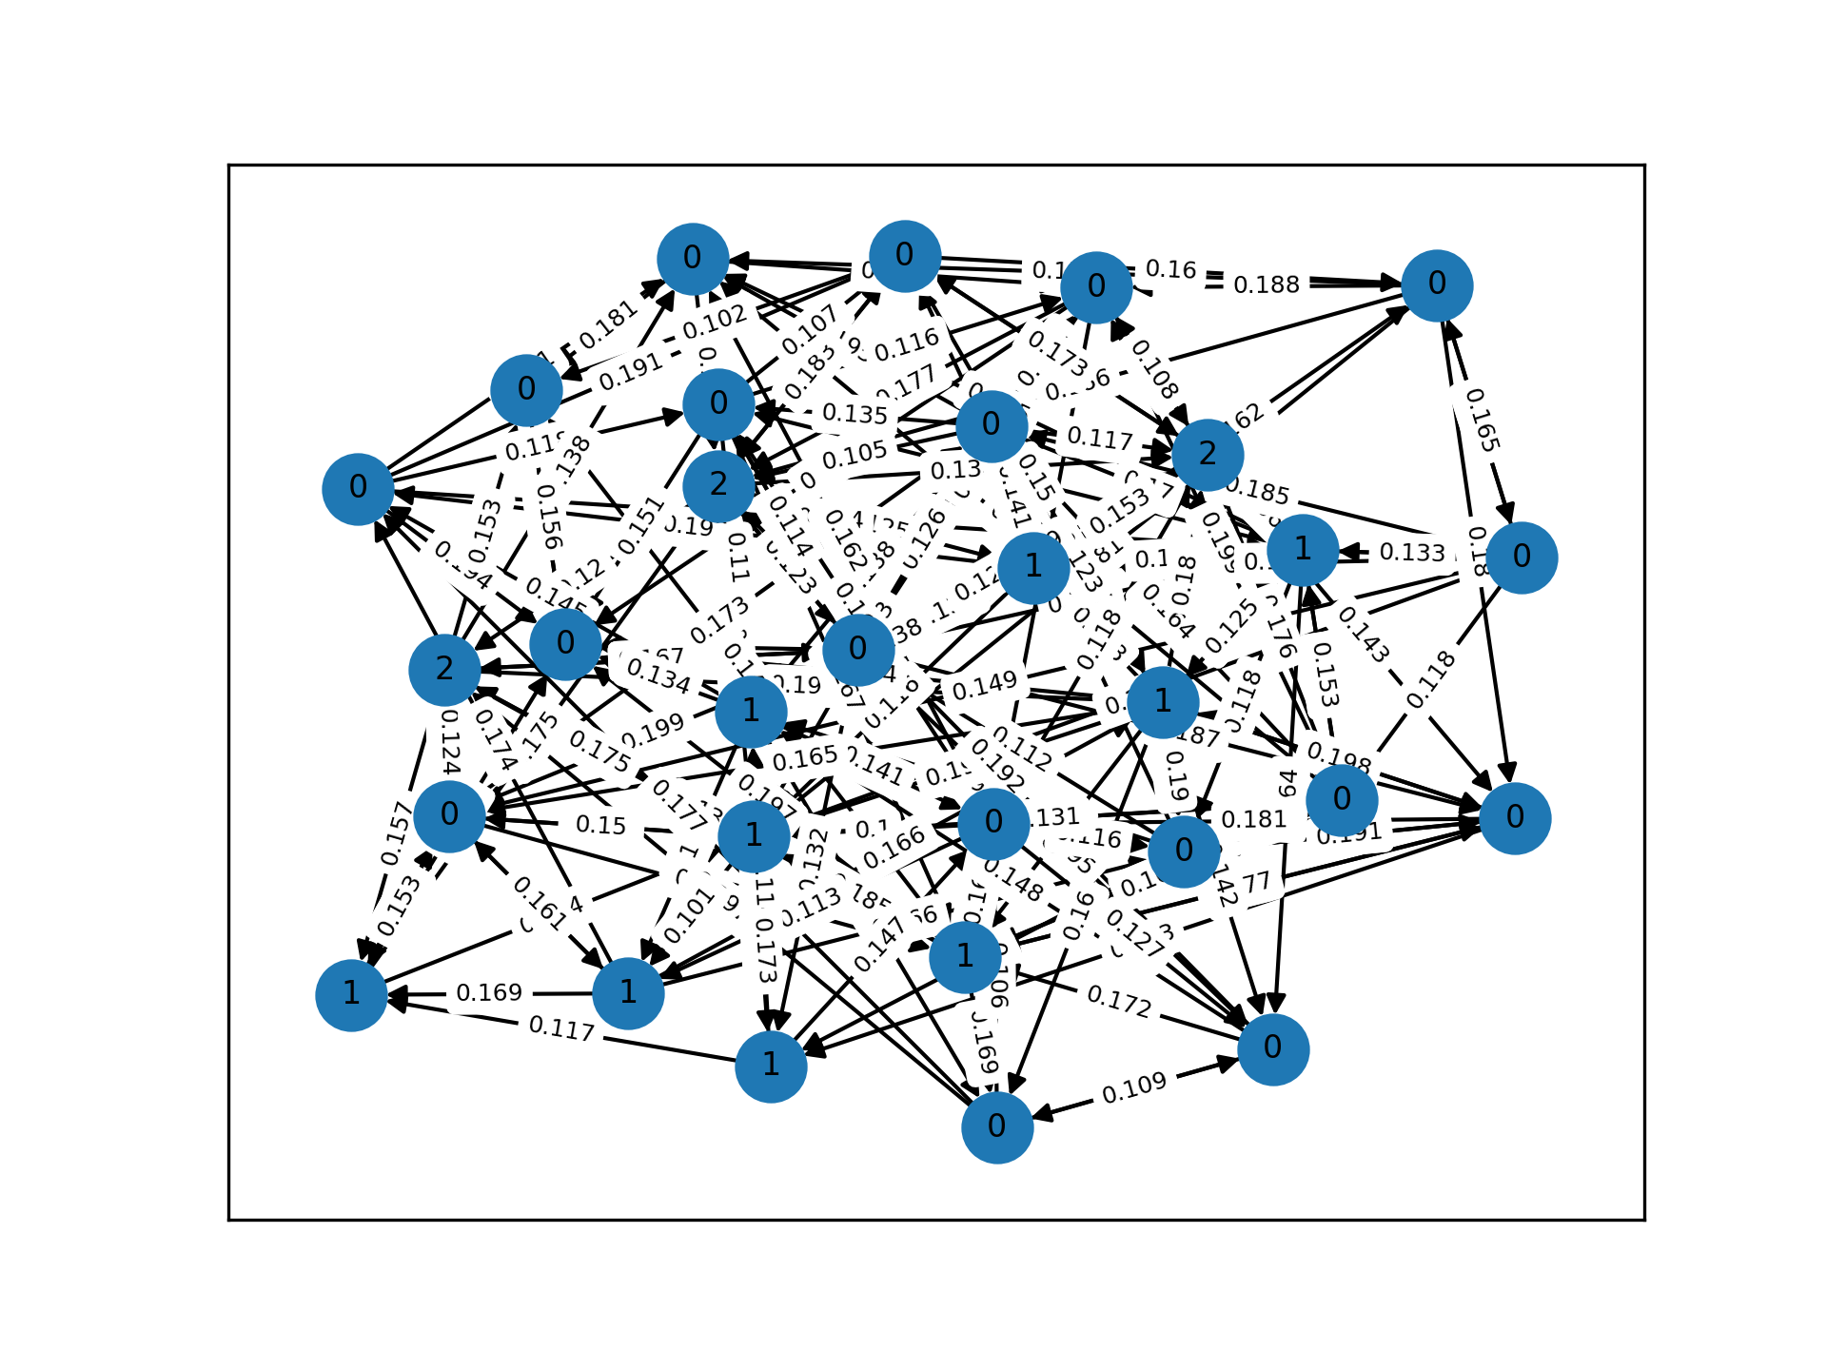
Problem Setting - Social Network Influence
Duration: Simulated over 365 days (T = 365).
Environment Details:
Operates on a subgraph of a social network containing 30 nodes.
Edges are directed, indicating one node as the influencer and the other as the influenced.
Edges are weighted, indicating activation probabilities of a given edge, reflecting the likelihood of influence spread between nodes.
Edge & Node Activations:
Within an influence episode, activations of nodes and edges are observable, serving as feedback for the learning process.
The true underlying probabilities governing these activations are hidden, making the learning task challenging.

Slide 4
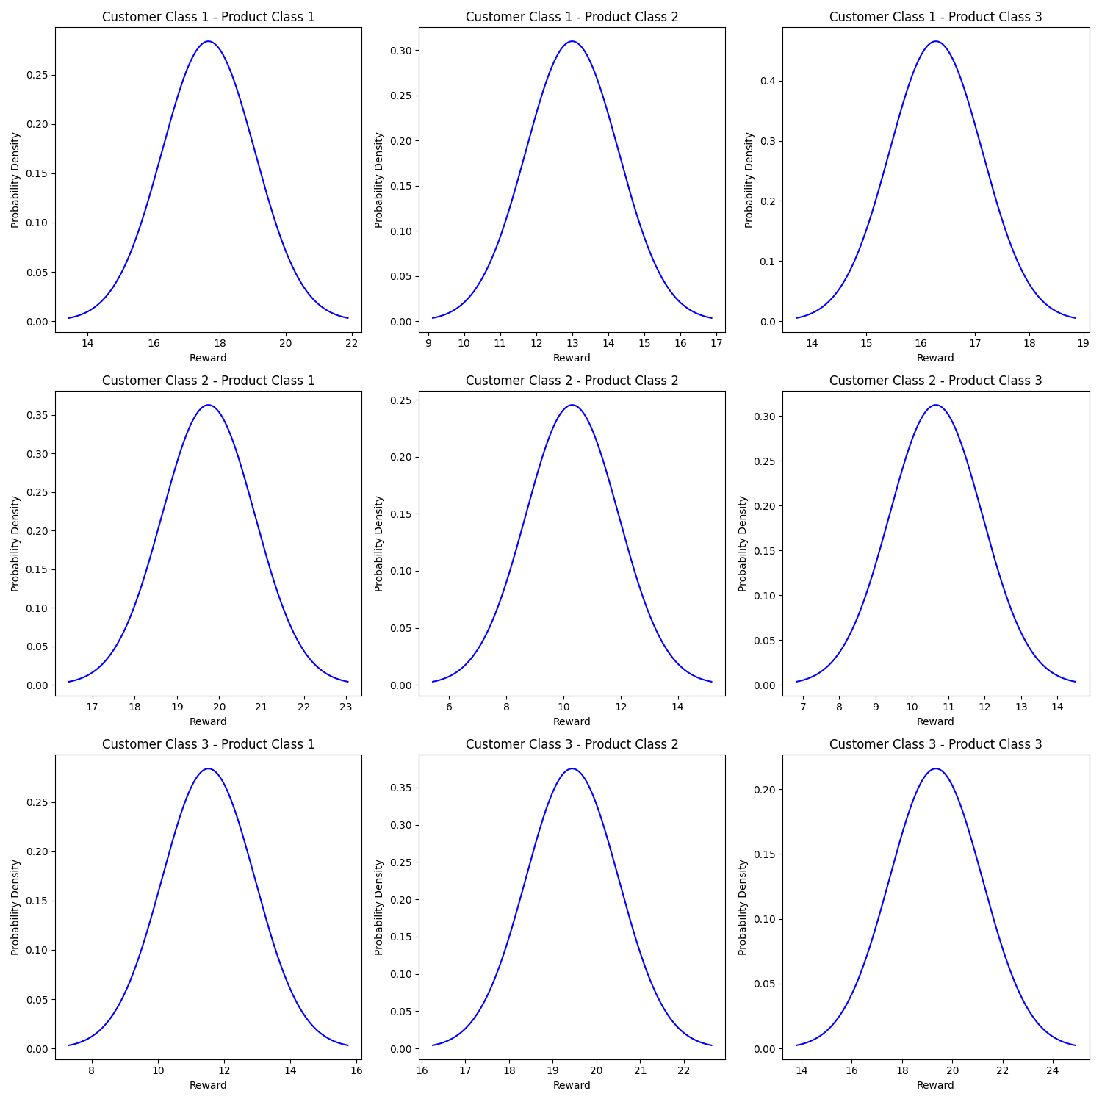
Problem Setting - Matching
Classifications:
Nodes (customers) are categorized into classes and have associated features determining their class assignment
Products are categorized into classes, but they don't possess distinct features.
Reward Structure:
Rewards are probabilistically determined, with the goal being to match customers to products in a way that maximizes the overall reward.
Inventory Constraints:
The inventory of each product class is limited to three units each per episode.

Slide 5
Clairvoyant Algorithm - Social Influence
Objective: To identify the optimal set of seeds that ensures the maximum influence spread within a social network, given a fixed budget. This algorithm, utilizing the exact probabilities of the network, sets a performance benchmark against which other learning algorithms can be measured.
Methodology:
Monte Carlo Simulations:
Harness the network's known probability distribution to perform Monte Carlo simulations, estimating the expected influence spread or reward from seeding specific nodes.
Greedy Seed Selection:
Iteratively:
Evaluate the potential influence of each seed, considering its combined effect with previously confirmed seeds.
Choose the seed that offers the most substantial incremental impact on influence spread.
This approach ensures a systematic build-up of seeds that together optimize the overall influence.
Optimal Influence Estimation:
With the optimal seed set determined, run additional simulations to ascertain the average influence spread and its variability for this combination.

Slide 6
Clairvoyant Algorithm - Matching
Objective: Determine the optimal matching between customer classes and product classes that maximizes the expected cumulative reward. Given the precise reward distributions for each pair, this algorithm provides an upper bound on the achievable rewards, serving as a yardstick for other strategies.
Methodology:
Reward Distributions:
Each pairing of a customer class and a product class has an associated reward, drawn from a normal distribution with unique means and standard deviations.
Constructing the Reward Matrix:
A matrix is built where each entry represents the expected reward for a specific customer-product class pairing.
To handle cases where there are mismatches in the number of customers and products, the matrix is padded with entries representing "no match".
Optimal Matching:
Using the reward matrix, the algorithm seeks the combination of customer-product pairings that maximize the overall expected reward.
This is achieved using an optimization technique (linear_sum_assignment) that finds the best assignment given the reward structure.

Slide 7
Models
Upper Confidence Bound (UCB):
Description: The UCB algorithm combines estimated rewards and corresponding confidence intervals to make selections. By consistently opting for the arm with the highest upper bound, UCB achieves an equilibrium between the exploration of new arms and the exploitation of familiar ones.
Thompson Sampling (TS):
Description: Thompson Sampling employs a Bayesian perspective, leveraging probabilistic reward distributions for each arm. At every step, the algorithm draws a sample from each arm's distribution, selecting the one with the highest value. This method adeptly balances exploration and exploitation.
Objective:
Modulate foundational TS and UCB algorithms to resonate with our unique problem dynamics.
Strategically engineer the problem to suppress elements elevating regret, with the ultimate goal of optimizing algorithmic efficacy.

Slide 8
Assumptions
Activation Probabilities: Activation probabilities are not observable.
Influence Episodes: Are independent and identically distributed (i.i.d).
Influence Propagation: Utilizes the Independent Cascade Model.
Customer Choices: Customers choose products based on their inherent preferences and the perceived quality of products.
Product Classification: product classes are always observable
Customer Information: Customer features are always observable

Slide 9
Step 1
Goals:
Utilize UCB and TS-like algorithms to deduce activation probabilities within the social network.
Aim to maximize the cumulative reward throughout the horizon.
Assumptions:
Activation probabilities adhere to stationary distributions.

Slide 10
Step 1 - UCB
Initialization:
Construct an n×n matrix as the upper confidence estimate for activation probabilities.
Initialize existing edges with infinity and other positions with zero.
Seed Selection:
Greedily choose seeds, emphasizing the expected marginal increase in reward.
Apply the UCB estimate to facilitate Monte Carlo simulations over n_runs.
Observation & Update:
Consider all potential activating edges as pulled arms.
Assign a reward of 1 for activated edges and 0 for the rest.
Update n_pulls
Repeat until t=T

Slide 11
Step 1 - TS
Initialization:
Set Beta parameters at 1, working with an assumed uniform distribution between 0 and 1.
Probability Estimation:
Define probabilities based on the ratio of successful activations to total chances.
Seed Selection:
Use the updated probabilities to determine a seed set using the same greedy strategy.
Observation & Update:
After each influence episode, for every edge that could be activated:
Increase alpha if activated, beta otherwise.
Repeat until t=T

Slide 12
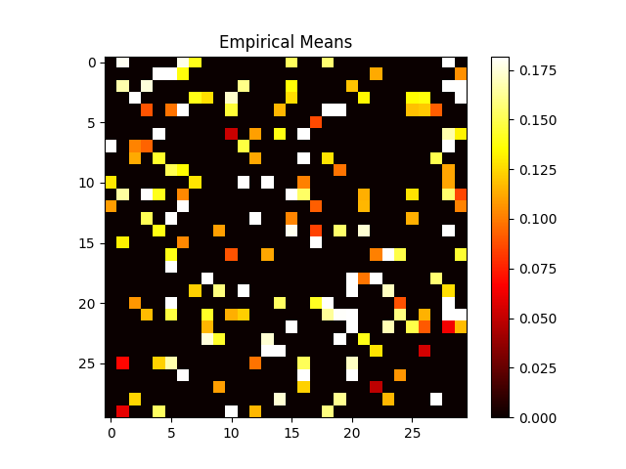
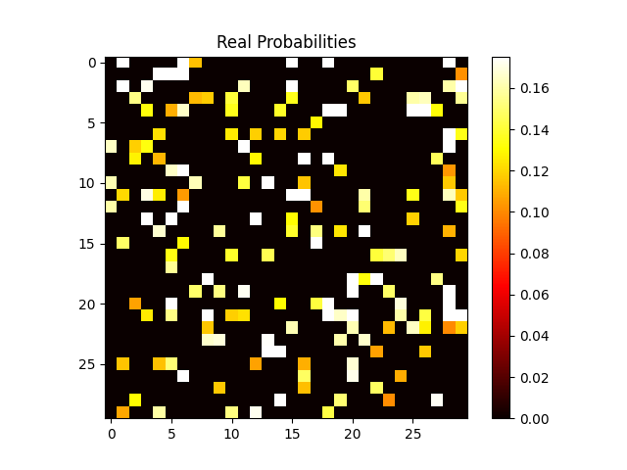
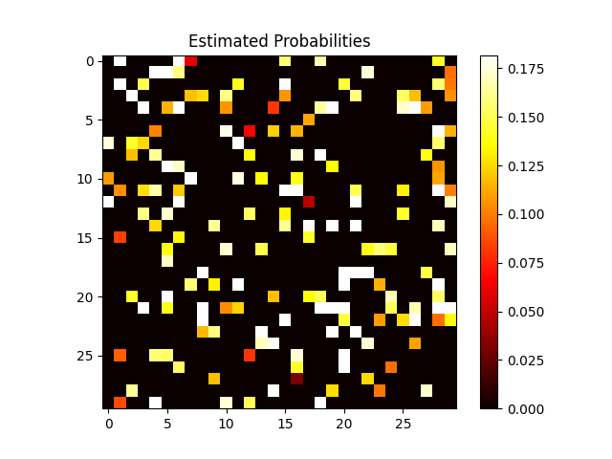
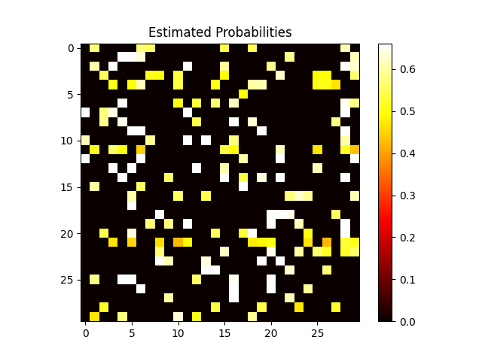
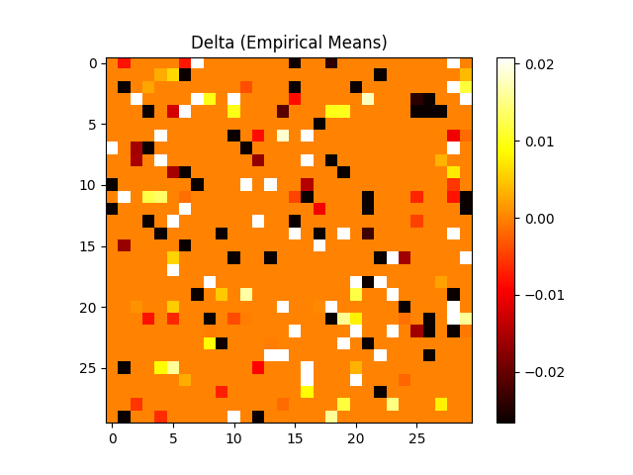
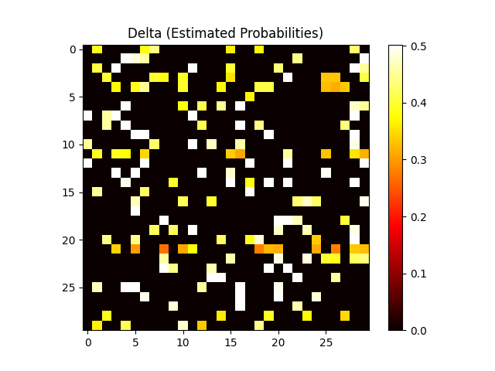
Activation Probabilities - UCB
TS Estimates
UCB Estimates (Confidence)
UCB Estimates (Empirical means)

Slide 13
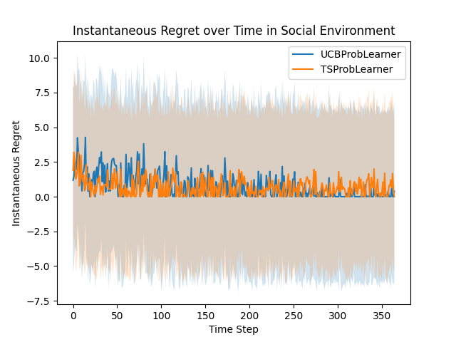
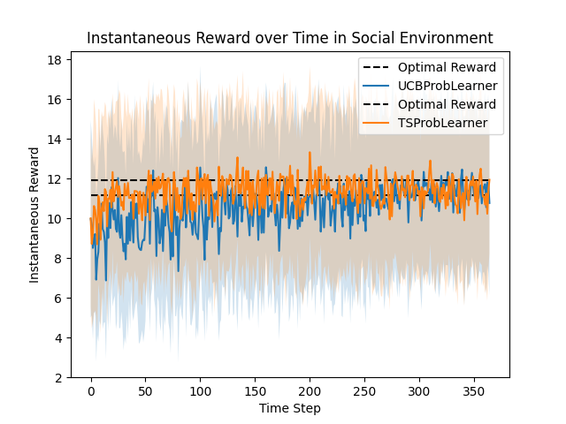
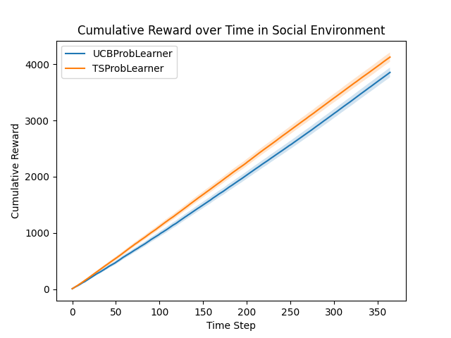
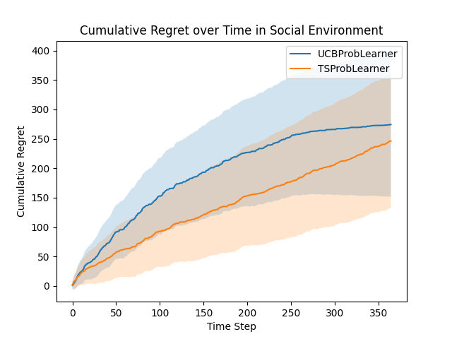
Step 1 - Results

Slide 14
Step 2
Goals
Maximize cumulative reward, i.e., optimize matches to maximize the mean rewards of the paired customer-product classes.
Assumptions:
Customer classes are observable.
Matching occurs post-influence episodes, meaning products are matched to all activated nodes at once.

Slide 15
Step 2 - UCB
Arm Representation:
Each arm represents the distribution mean of a specific customer-product class pairing.
Initialization:
Form a matrix of reward distribution means for all customer-product class pairs, initializing all UCB values to infinity.
Round Mechanics:
At each round, the bandit gets a list of available customers and their projected classes.
This list helps construct a matrix (dimensions: n-customers x n-products) where rows represent individual customers and columns individual products.
Arm Selection & Update:
Determine arms by computing the optimal assignment using the Hungarian algorithm.
Refine estimates and confidence intervals based on the realized rewards from the proposed matching.

Slide 16
Step 2 - NIG-TS
Distribution & Parameters:
The Normal Inverse Gamma (NIG) distribution, characterized by parameters, μ (prior mean), λ (prior count), α (shape), and, β (scale), is used as the prior for the reward distributions of customer-product class pairings.
Initialization:
Parameters are set to reflect non-informative priors, symbolizing a lack of initial knowledge. For instance, a small λ indicates high uncertainty about the mean reward.
Sampling:
At each round, samples are drawn from the current NIG distributions to estimate possible reward outcomes.
Matching:
Based on the samples, compute the optimal matching between products and customers.
Update:
After observing the realized rewards, Bayesian updating refines the NIG parameters, encapsulating the newly acquired knowledge.

Slide 17
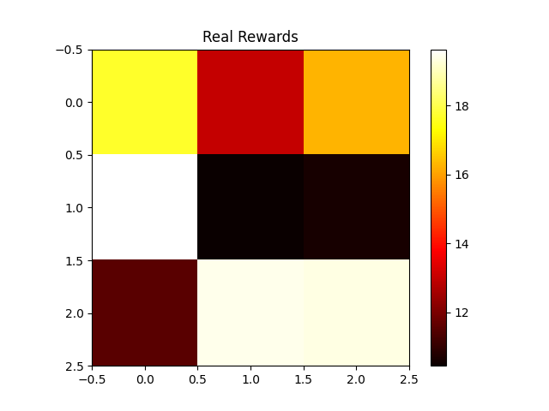
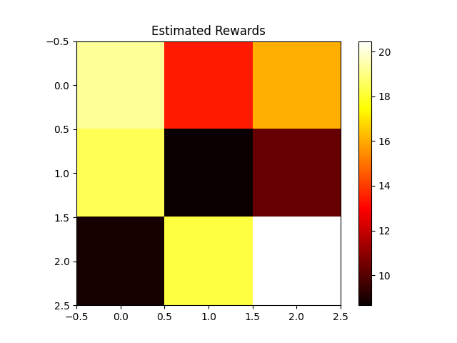
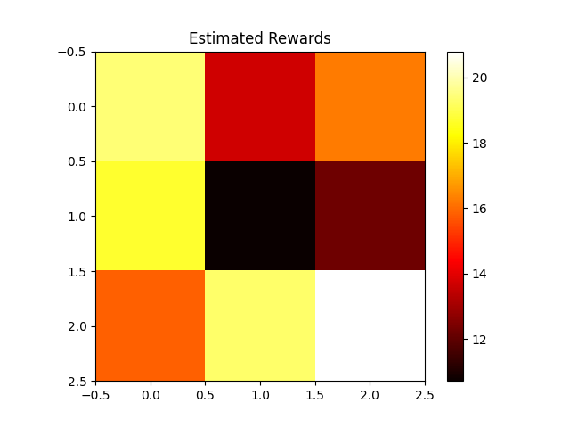
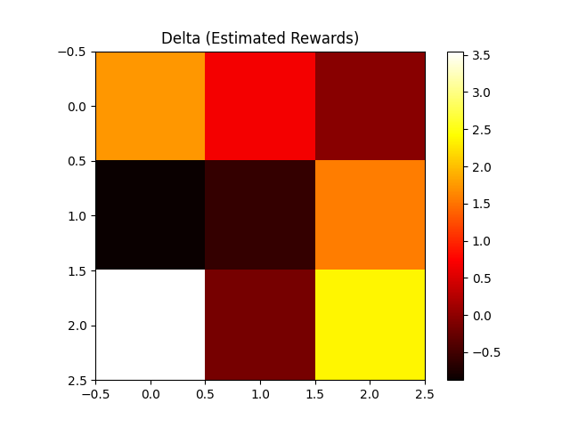
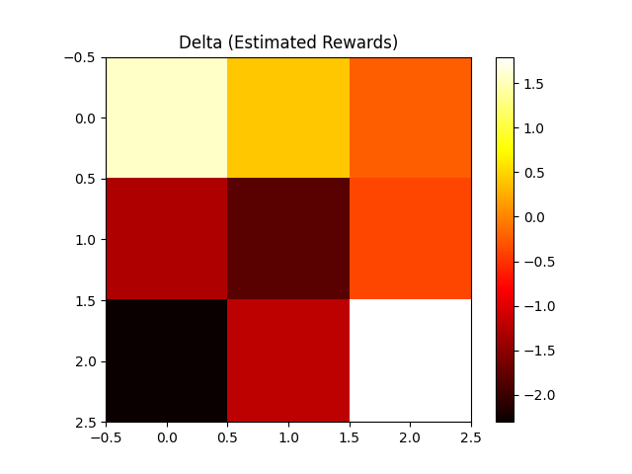
Expected Rewards Estimates

Slide 18
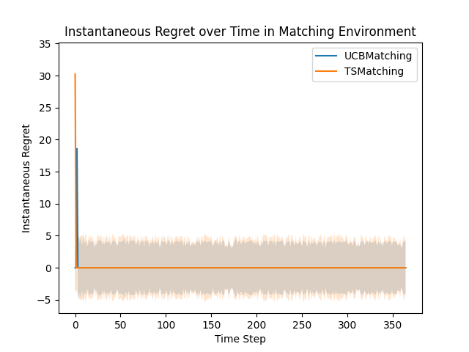
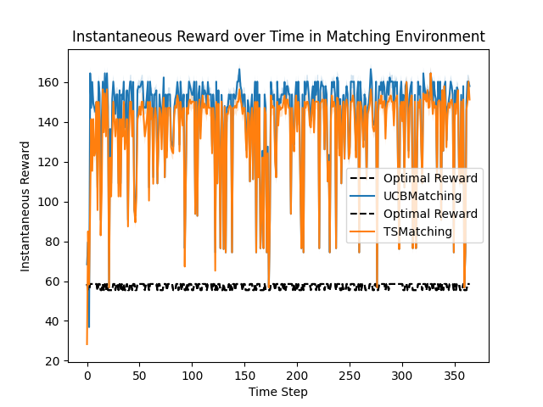
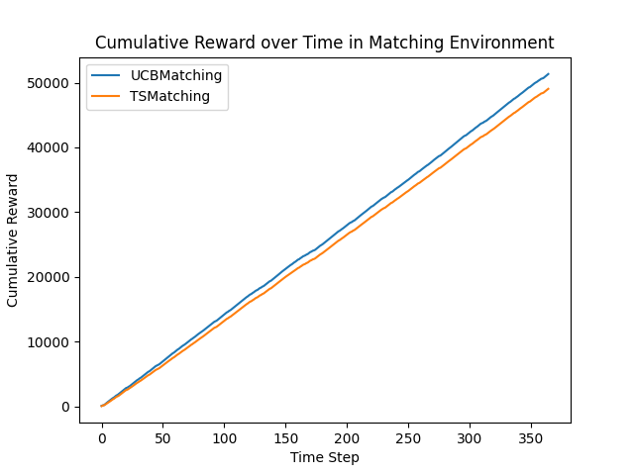
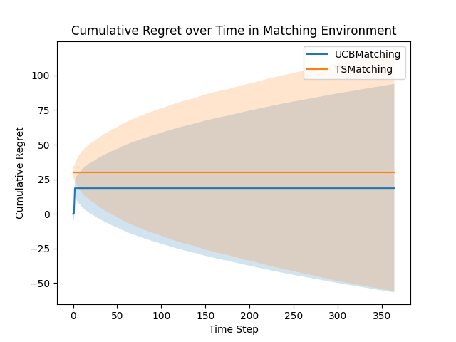
Step 2 - Rewards

Slide 19
Step 3
Goals
By integrating these models, which would operate in tandem in real-world applications, we aim to obtain a more accurate and holistic picture of performance.
Assumptions:
Customer classes are observable.
Matching occurs post-influence episodes, meaning products are matched to all activated nodes at once.

Slide 20
Step 3
Influence Maximization:
Using the methodologies from Step 1, employ UCB or NIG-TS algorithms to estimate activation probabilities within the social network; with a set maximum of seed nodes, maximize the number of nodes influenced or activated in the network.
Observation After Influence:
At the conclusion of each influence episode, identify and categorize the nodes that were successfully activated.
Extract the class labels of these active nodes. This data represents the potential customer base for the matching phase.
Matching Algorithm Integration:
The class labels from the activated nodes serve as input to the matching algorithm from Step 2.
Using either UCB or NIG-TS the algorithm attempts to find the optimal match between products and influenced customers.

Slide 21
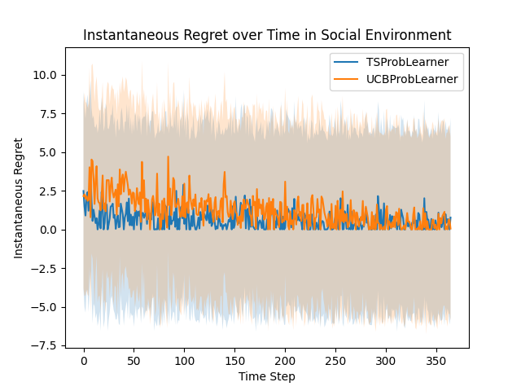
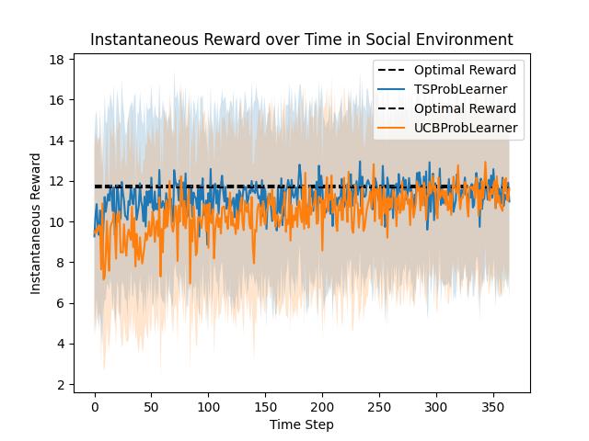
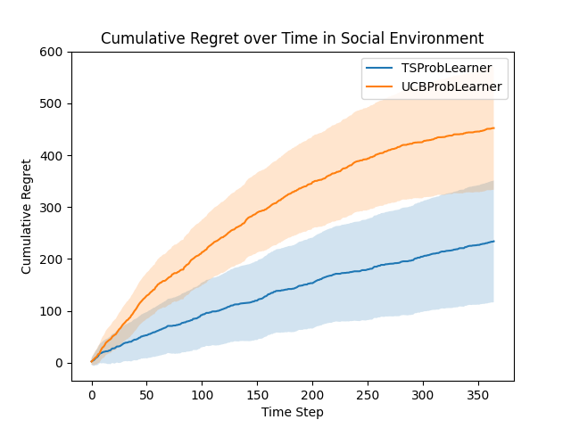
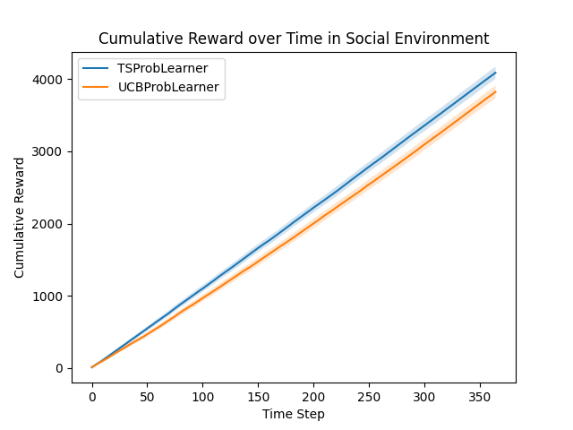
Step 3 - Result (Social)

Slide 22
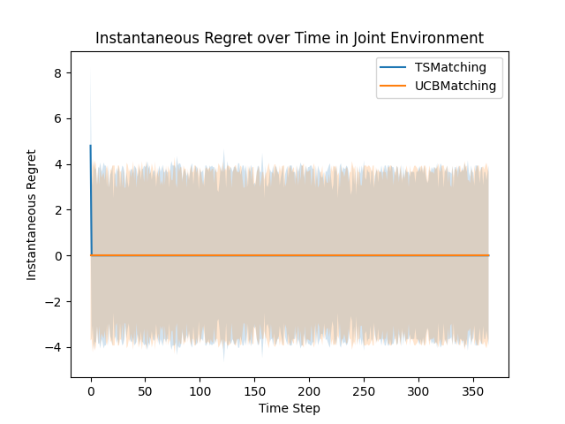
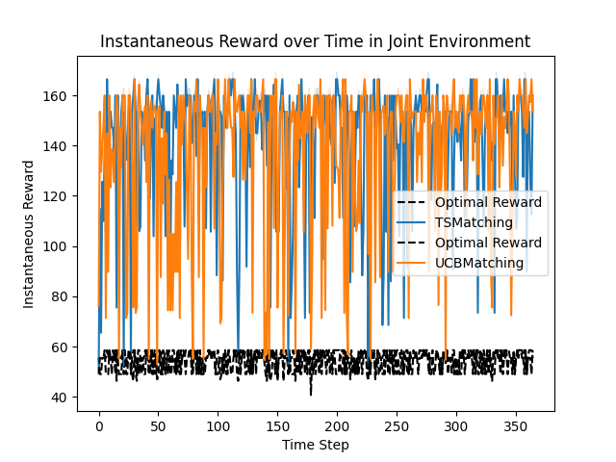
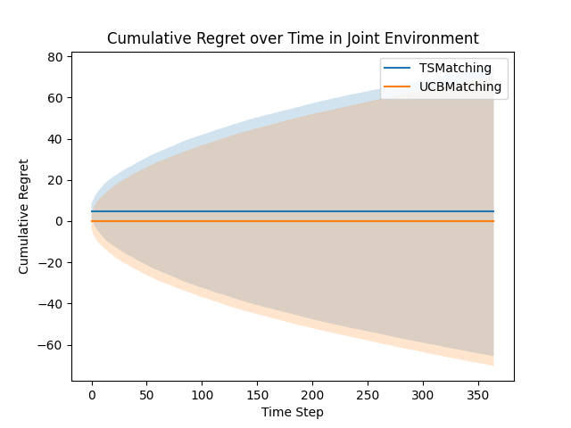
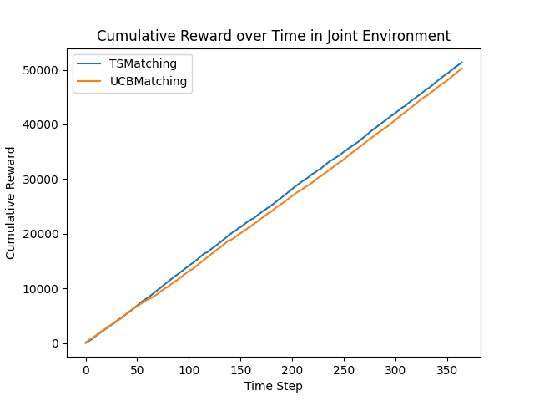
Step 3 - Result Final

Slide 23
Step 4
Goals
Test model performance in the more realistic and generalised scenario in which customer classes are not observable
Assumptions:
The underlying structure of customer contexts is not observable. Specifically, the number of classes and the divisions within features remain unknown.
Individual customer features are observable.
Activation probabilities do not depend on these features.
Product classes are observable.

Slide 24
Step 4
Influence Maximization:
Influence maximization proceeds as described in Step 3, emphasizing the maximization of reach within the social network.
Initialization for Matching:
Start with no assumed customer classes. The estimated reward matrix is initialized with a 1x3 structure. This is because, in the absence of distinct customer classes, all customers belong to a single class, while products are differentiated into three classes.
Data Accumulation:
After each matching round, store a triplet for every match. This triplet comprises:
Customer features
Product class
Observed reward
Aggregate these triplets into a 'dataset' for subsequent processing.
Context Generation:
Every 14 days, process this 'dataset' using a context generation algorithm. This involves hierarchical clustering to segment customers into distinct classes.
Accept a division or split within this context structure only if its lower bound on expected value augments the overall expected value.
Adaptive Arm Configuration:
Adjust the arms (representing different customer-product matches) based on the newly identified splits.
Append an additional row of estimates for each new split.
Recalculate these estimates using the aggregated 'dataset'.

Slide 25
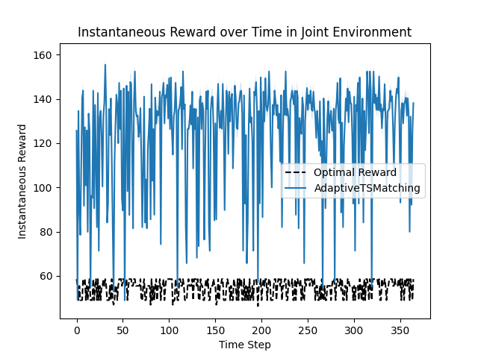
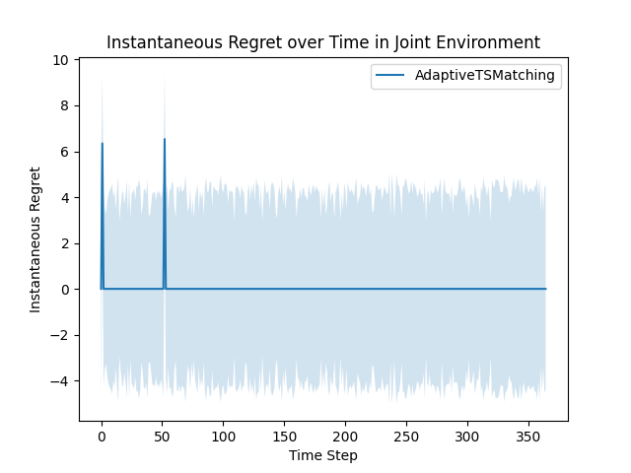
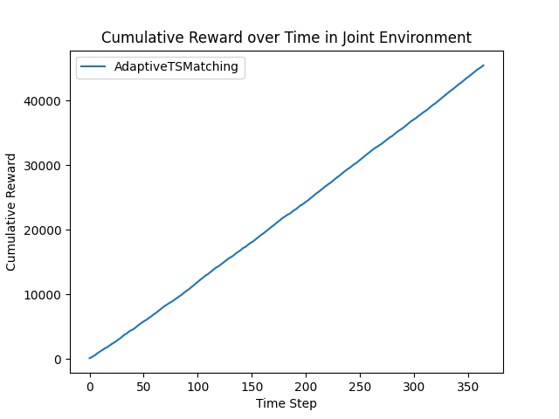
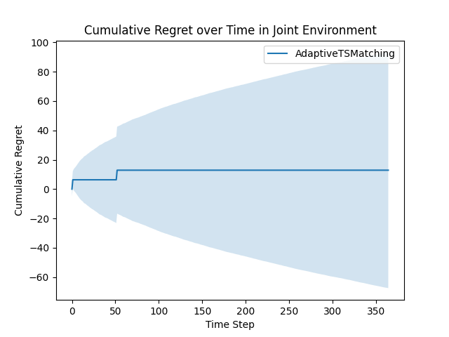
Step 4 - Results

Slide 26
Step 5
Goals
Test model performance in the more realistic and generalised scenario in which the stationarity assumption of edge activation probabilities does not hold
Assumptions:
Activation probabilities are no longer stationary, suggesting that the likelihood of node activation can change over time.
The number of phases (distinct periods with consistent activation probabilities) is known. However, the exact length and the start of each new phase remain unpredictable.
Graph structure, other than probabilities is unchanged

Slide 27
Step 5 - Non-Stationary UCB
Passive Approach - Sliding Window:
Concept: To navigate fluctuating activation probabilities, this method focuses on a recent subset of data, defined by a "sliding window" of a fixed size. It emphasizes recent trends, adapting to the latest changes in the environment.
Rationale: Traditional UCB uses all historical data, potentially treating old and new observations equally. In stationary settings, the sliding window method might lose some accuracy. However, in dynamic environments, its adaptiveness is an advantage.
Active Approach - Change Detection UCB (CD-UCB) using CUSUM:
Concept: Actively monitors activation probabilities for significant changes. On detecting a shift, it resets, making it agile to evolving environments.
Difference from Standard UCB: CD-UCB's active monitoring might lead to unnecessary resets in stationary settings, impacting performance. However, in changing environments, it often outperforms the standard UCB.
CUSUM (Cumulative Sum) is a statistical method that tracks the cumulative sum of deviations from a mean. When this sum crosses a predefined threshold, it indicates a potential shift in the underlying process. In the context of CD-UCB, it's used to detect changes in activation probabilities.

Slide 28
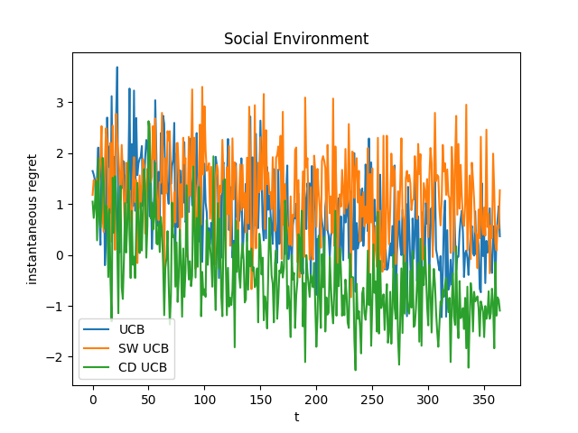
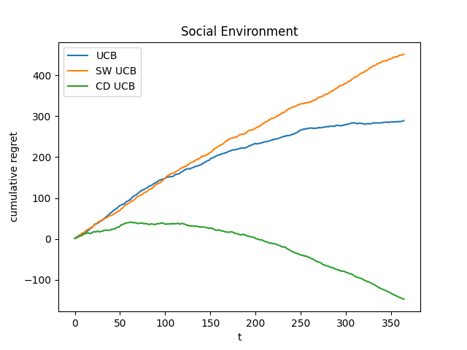
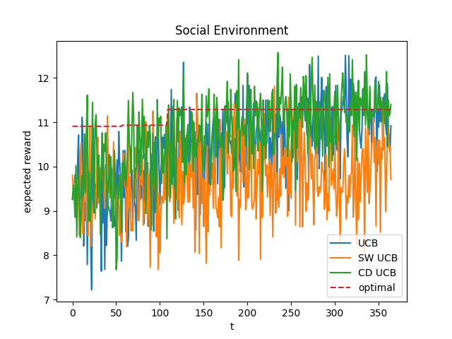
Step 5 - Results

Slide 29
Step 6
Goals
Test model performance in the more realistic and generalised scenario in which the stationarity assumption of edge activation probabilities does not hold, and no knowledge about the seasonality is available either
Assumptions:
Environments experience random, frequent, and unpredictable changes.
No prior knowledge about the form of non-stationarity.

Slide 30
Step 6 - EXP3
Probability Distribution:
Maintains a distribution over arms. Arm's probability increases with better rewards.
Ensures a balance between exploring all arms and exploiting the best ones.
Weights & Updates:
Each arm has a weight. This weight grows exponentially with the arm's reward.
Role: Determines the likelihood of selecting an arm in subsequent rounds.
Key Parameters:
Learning Rate (γ): Dictates the adaptation speed to new rewards.
Probability Distribution (pi​): Influenced by weights, it guides arm selection.
High stochasticity; Adapts swiftly to environmental changes identifying new optimal strategies post-change.

Slide 31
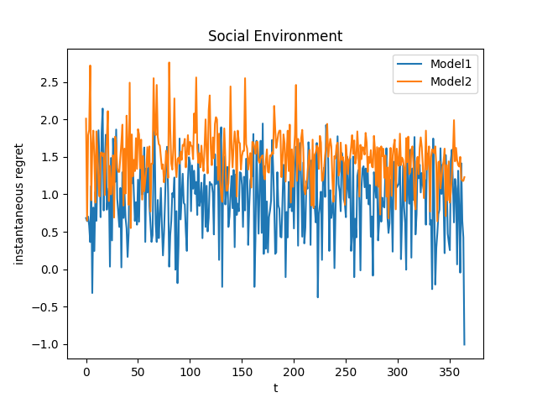
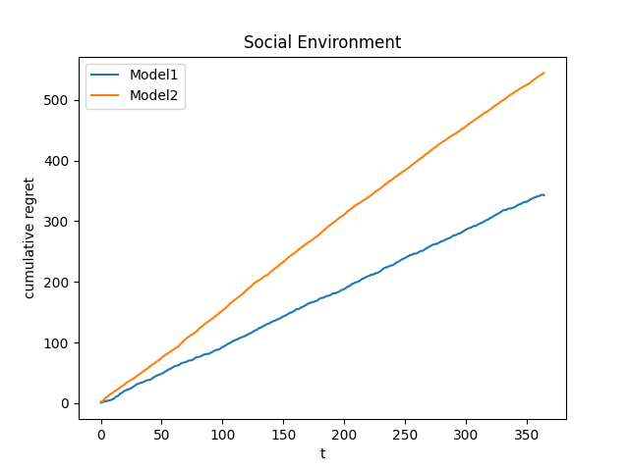
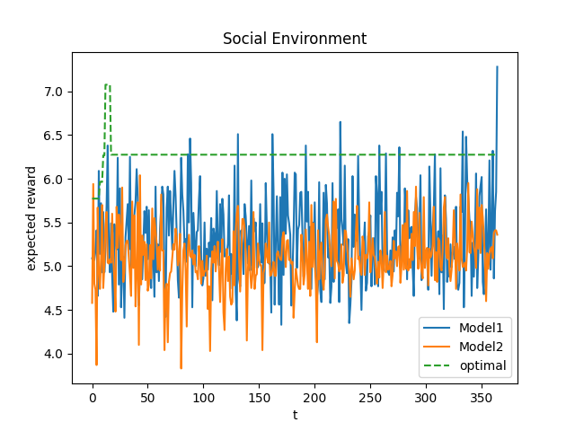
Step 6 - Results

